Slide 1

Electrical Signalling in Bacterial Biofilms
A study of bacterial biofilms using Agent Based Models (ABMs)
A model and statistical analysis on data outlining electrical signalling by potassium ions
3rd Year Laboratory:
Luke Peters: 10204030 & Peng Wang: 10794677

Slide 2
What is a biofilm?
A biofilm is an architectural colony of micro-organisms, within a self-produced matrix of extracellular polymeric substance (EPS).
Biofilms contains microbial cells adherent to one-another and to a static surface (living or non-living).

Slide 3
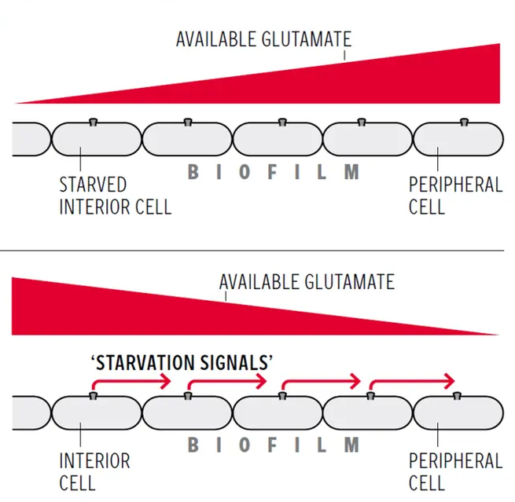
Communication Mechanism
Glutamate is a central metabolite in all organisms.
Central cells respond to glutamate starvation by opening their potassium (K+) channels. This nutrient stress is transferred to outer cells.
Outer cells respond to this signal by reducing their glutamate usage.
The results in an increased protection of the entire community from chemical attack.

Slide 4
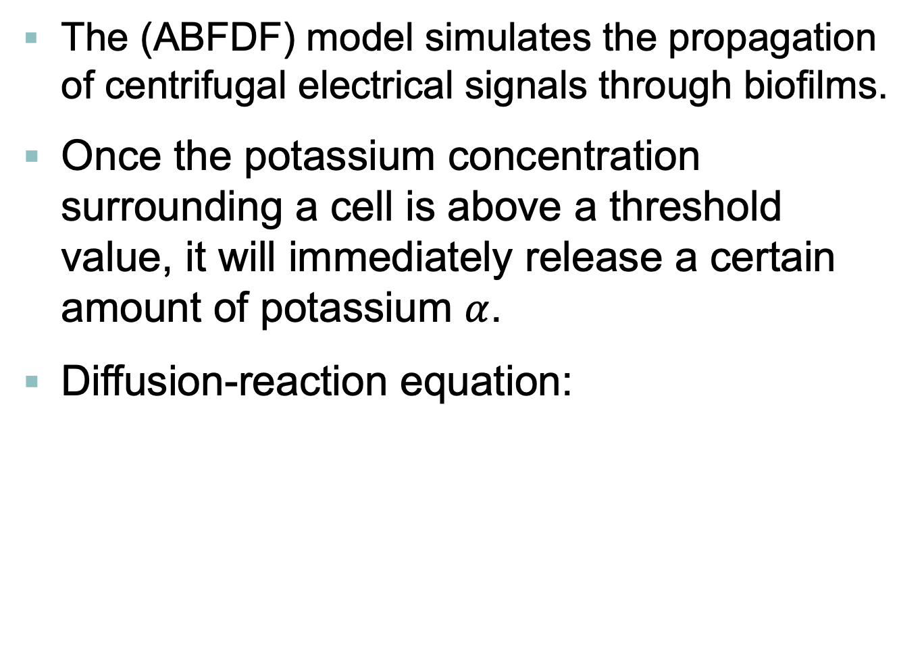
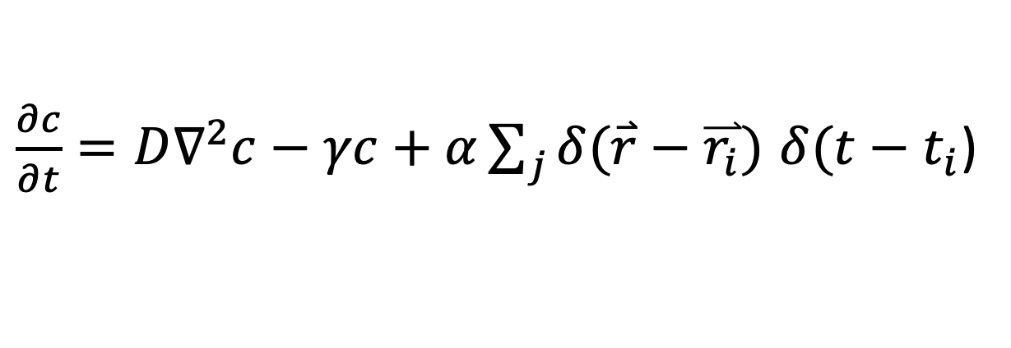
Agent Based Models
The (ABFDF) model simulates the propagation of centrifugal electrical signals through biofilms.
Once the potassium concentration surrounding a cell is above a threshold value, it will immediately release a certain amount of potassium $α$.
Diffusion-reaction equation:
$\frac{∂c}{∂t}={D∇}^{2}c−γc+α\sum_{j}{δ(\overset{⃑}{r}−\overset{⃑}{r_{i}})}$ $δ(t−t_{i}$)
($γ$ is the degradation coefficient, D is the diffusion coefficient)

Slide 5
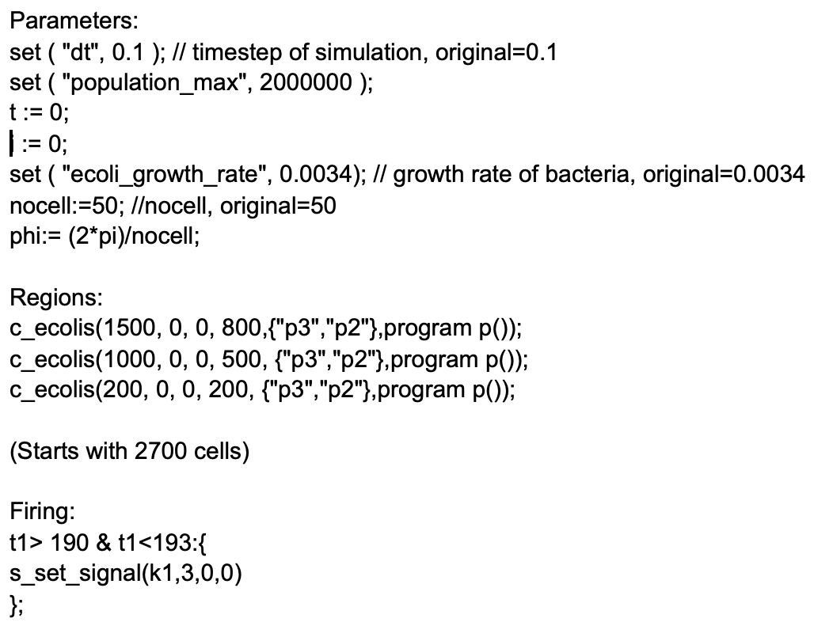
Parameter Settings
The GRO file we will use is ABFDFM(1)(4).gro

Slide 6
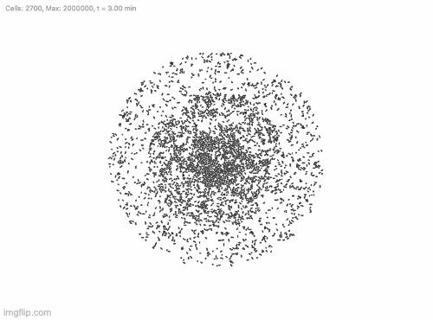
How Does It Look?

Slide 7
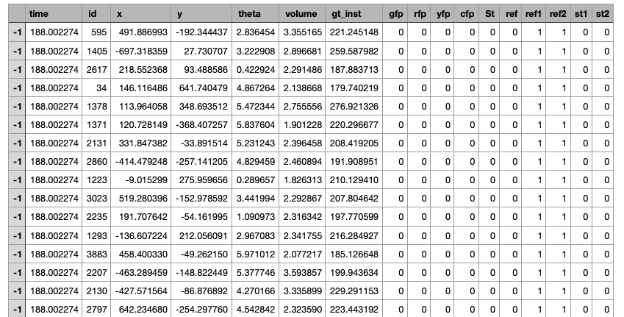
How Does It Look?

Slide 8
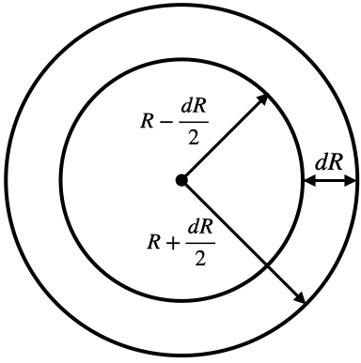
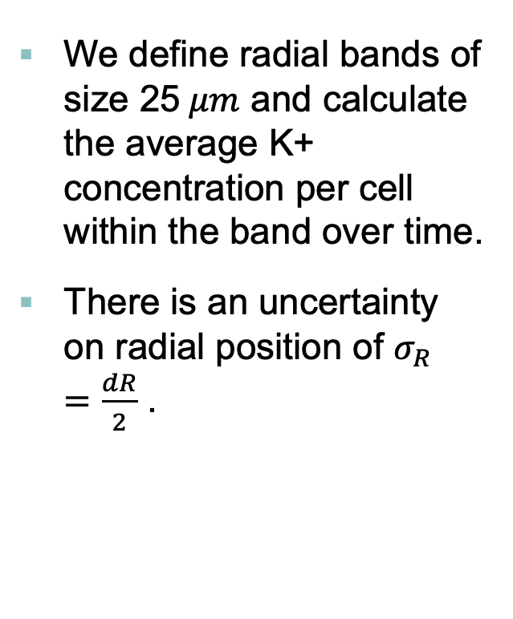
Potassium Profile
We define radial bands of size 25$μm$ and calculate the average K+ concentration per cell within the band over time.
There is an uncertainty on radial position of $σ_{R}=\frac{dR}{2}$ .

Slide 9
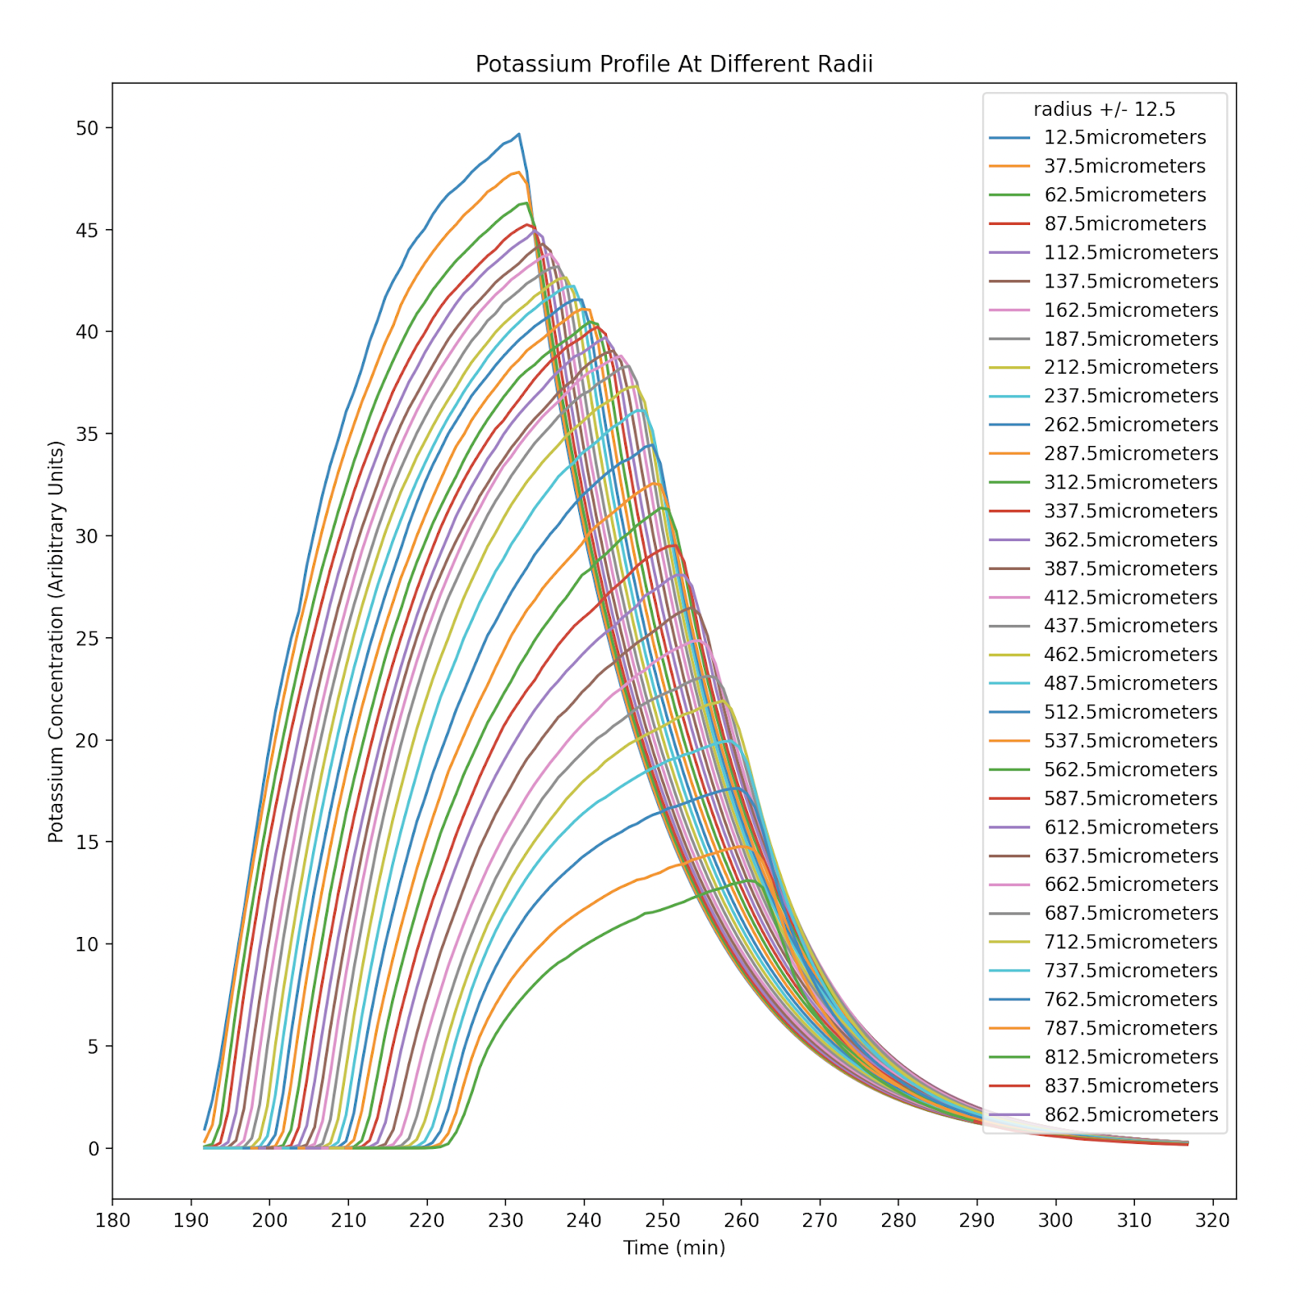
Potassium Profile
This plot is average K+ conc. Per cell at radius R against time.
The peaks in concentration propagates outwards, indicating a centrifugal potassium wave.
We define the peak in average concentration as a point of constant phase.

Slide 10
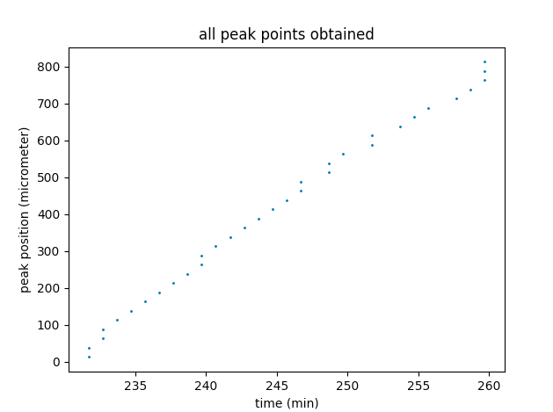
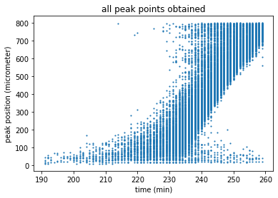
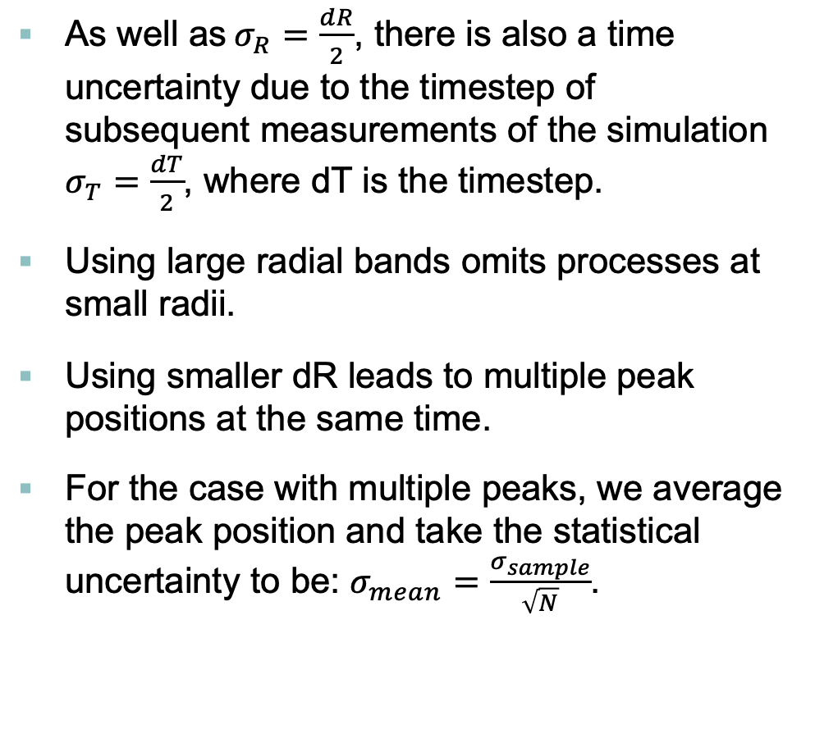
Peak Position
As well as$σ_{R}=\frac{dR}{2}$, there is also a time uncertainty due to the timestep of subsequent measurements of the simulation $σ_{T}=\frac{dT}{2}$, where dT is the timestep.
Using large radial bands omits processes at small radii.
Using smaller dR leads to multiple peak positions at the same time.
For the case with multiple peaks, we average the peak position and take the statistical uncertainty to be: $σ_{mean}=\frac{σ_{sample}}{\sqrt{N}}$.

Slide 11
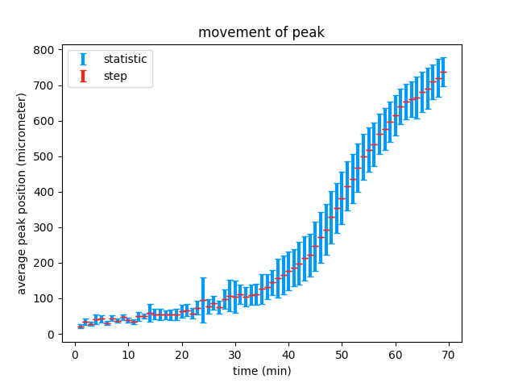
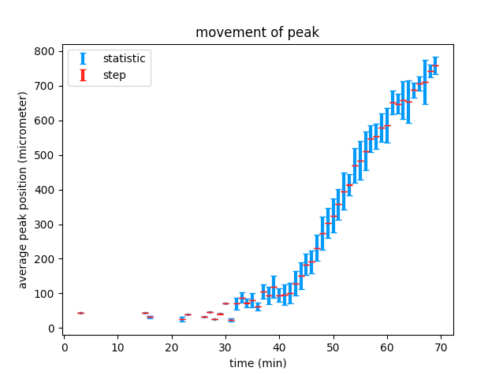
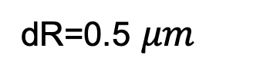
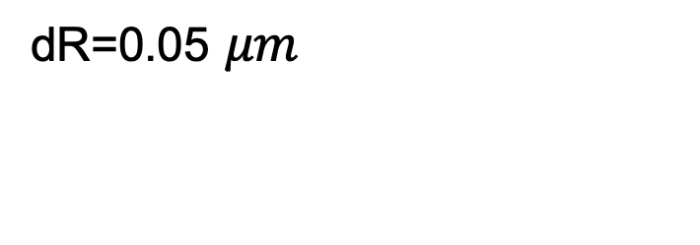
Peak Position
dR=0.5 $μm$
dR=0.05 $μm$
At low radii the statistical uncertainty is of reasonable size, however, quickly becomes too large as radii increases.
At low radii we cannot discern any detail, however, at large radii the statistical uncertainty is more reasonable.

Slide 12
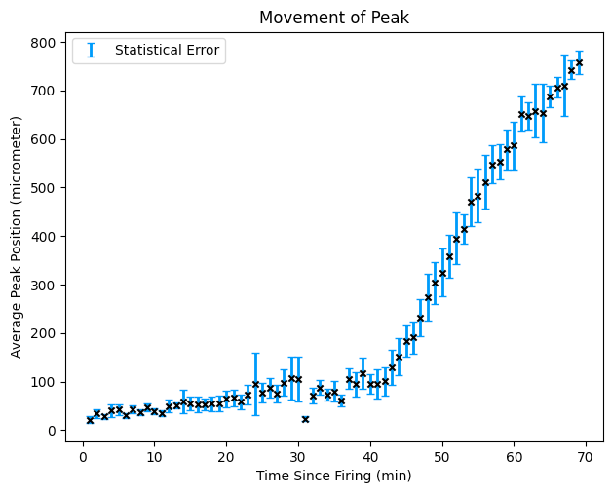
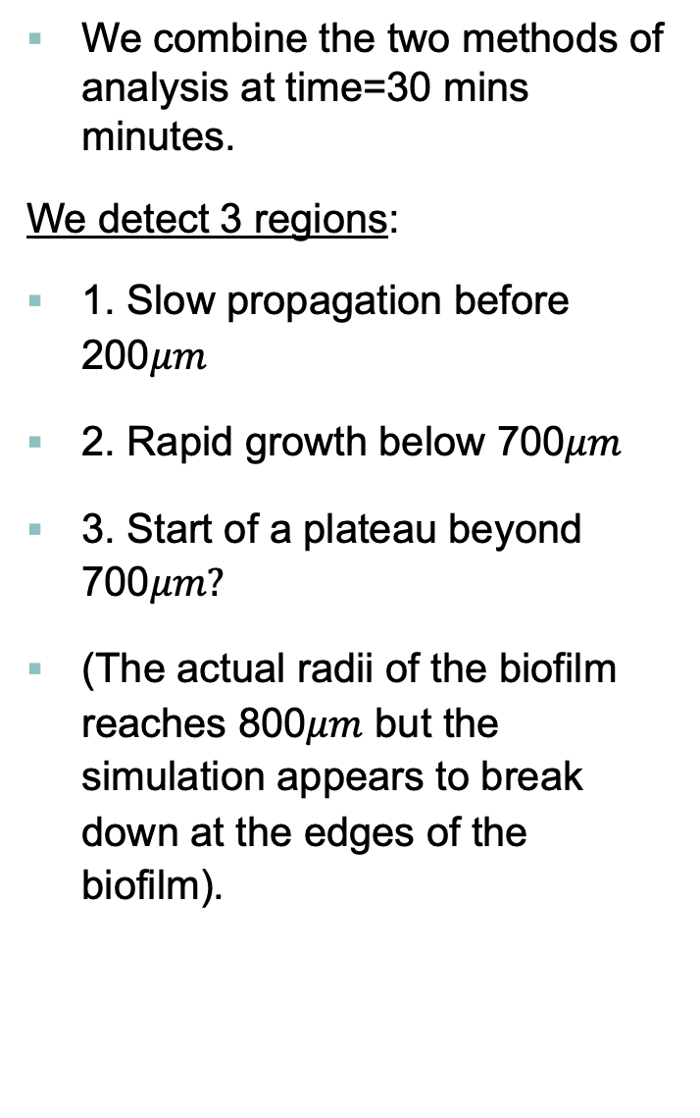
Peak Position
We combine the two methods of analysis at time=30 mins minutes.
We detect 3 regions:
1. Slow propagation before 200$μm$
2. Rapid growth below 700$μm$
3. Start of a plateau beyond 700$μm?$
(The actual radii of the biofilm reaches 800$μm$ but the simulation appears to break down at the edges of the biofilm).

Slide 13
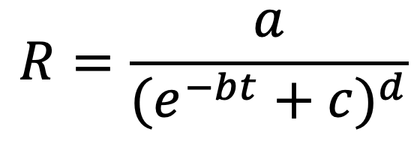
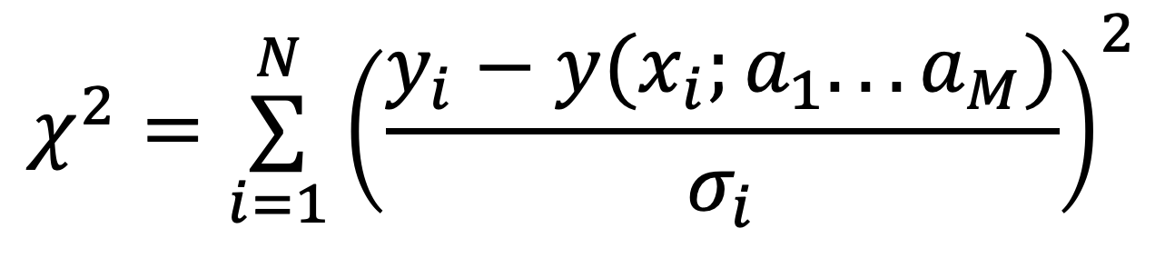
Peak Position
We decide to fit a parameterised sigmoid function using scipy.optimize:
As a “goodness of fit” parameter we use the reduced chi-squared
(This is reduced by dividing by DOF=N-1
$$R=\frac{a}{(e^{−bt}+c)^{d}}$$
$$χ^{2}=\overset{N}{\underset{i=1}{∑}}{\left(\frac{y_{i}−y(x_{i};a_{1}...a_{M})}{σ_{i}}\right)}^{2}$$

Slide 14
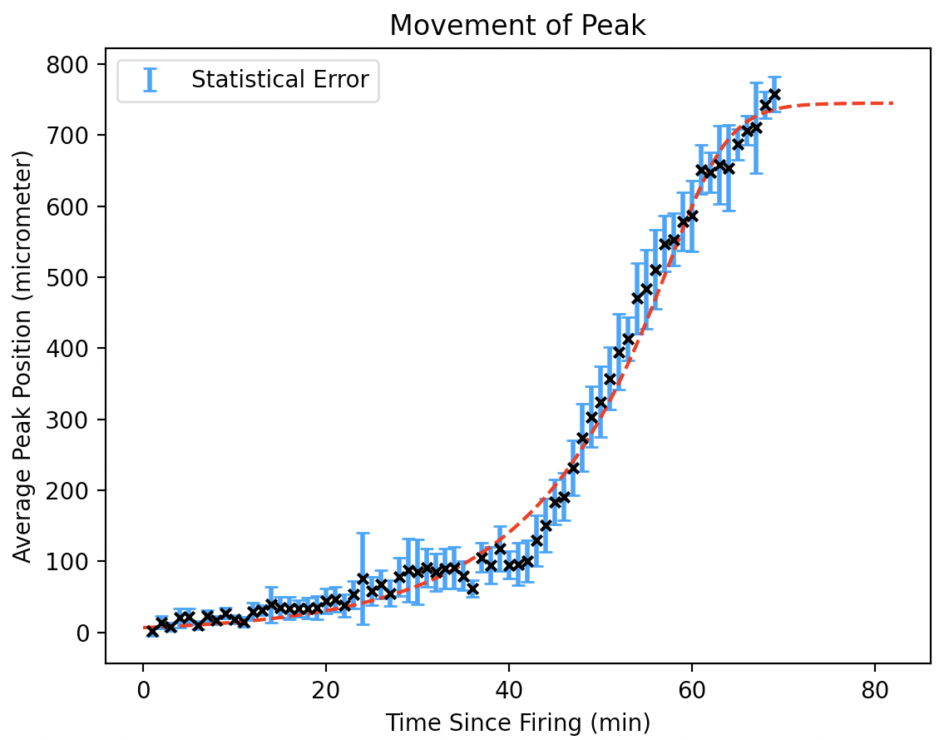
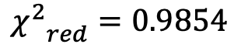
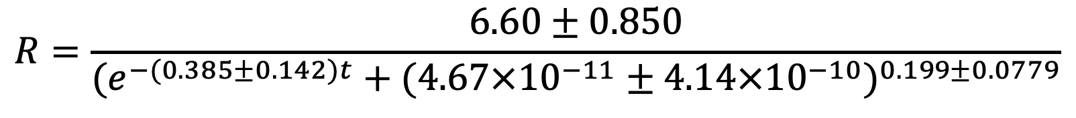
Peak Position
$${χ^{2}}_{red}=0.9854$$
$$R=\frac{6.60±0.850}{(e^{−(0.385±0.142)t}+(4.67×{10}^{−11}±4.14×{10}^{−10})^{0.199±0.0779}}$$

Slide 15
Peak Position
“Lag” - The release of K+ ions takes some time to finish.
Hence the release and accumulation of the peak concentration don’t happen instantaneously.
i) The position of the peak is behind the most recently activated cell.
ii) The peak’s formation is affected by the “forward” and “backward” cells.
Peak
(Centrifugal Wave)
Forward Cells
Backward Cells

Slide 16
Peak Position
1.The starting phase - First set of cells are arbitrarily activated, there is no backward cells.
2.The stable phase - The system reaches a balance, backward cells and forward cells contribute.
3.The decaying phase - The peak approaches the edge of the colony, there is a lack of forward cells (potassium has diffused out of the colony/degraded without triggering new cells.
3
2
1

Slide 17
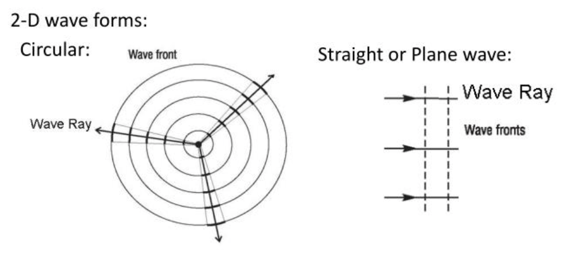
Velocity
To create a general description of the movement of the wave, we analyse the average velocity of the wavefront.
Waves travelling in the biofilm originate from a point source so are curved rather than planar.
A wave’s curvature (1/R) affects the wave’s radial velocity.

Slide 18

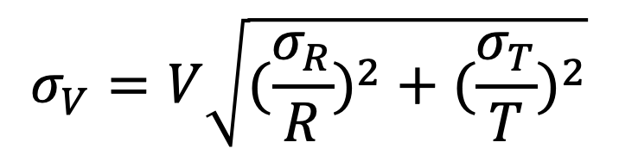
Velocity
In our analysis we used the average velocity:
We use the prior methodology for calculating the step and statistical uncertainties on the peak positions and times.
These are propagated in fractional quadrature using:
V$=\frac{R}{T}$
R-radial position of wavefront
T-time since initial potassium fire
$$σ_{V}=V\sqrt{(\frac{σ_{R}}{R})^{2}+(\frac{σ_{T}}{T})^{2}}$$

Slide 19
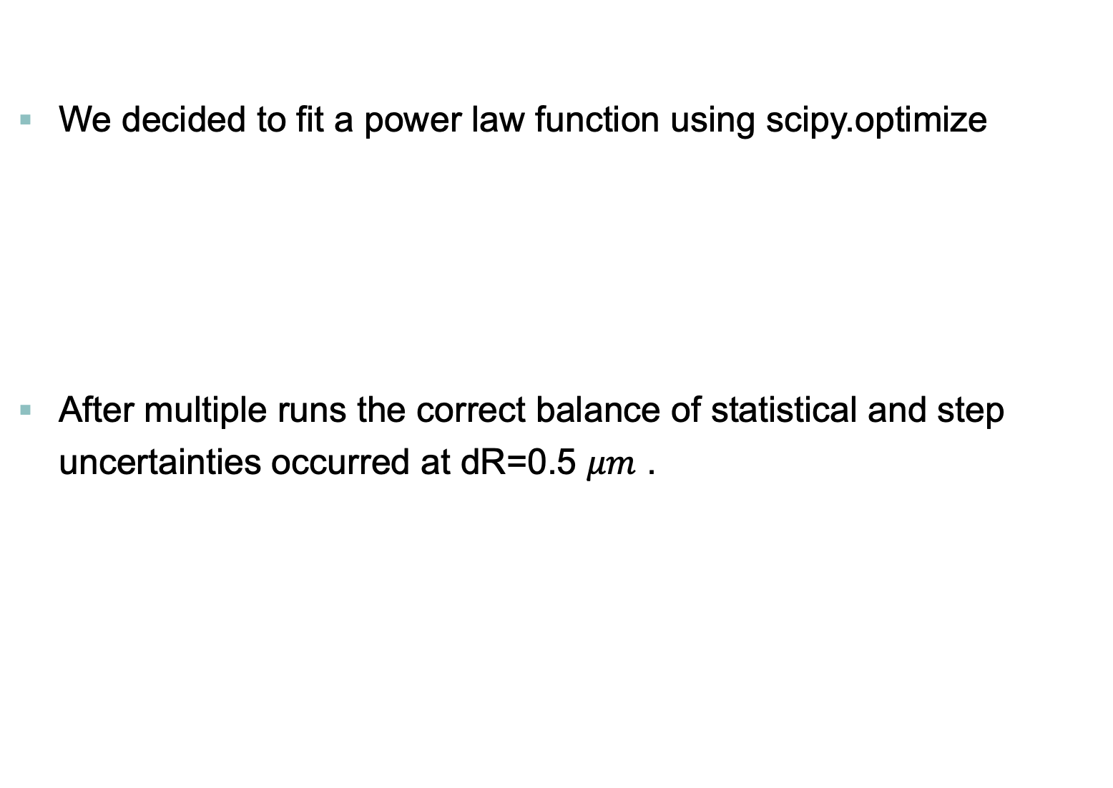
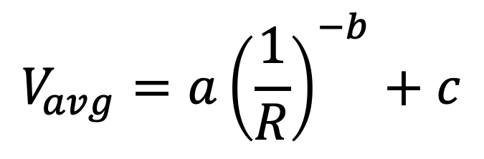
Velocity
We decided to fit a power law function using scipy.optimize
After multiple runs the correct balance of statistical and step uncertainties occurred at dR=0.5 $μm$ .
$$V_{avg}=a{\left(\frac{1}{R}\right)}^{−b}+c$$

Slide 20
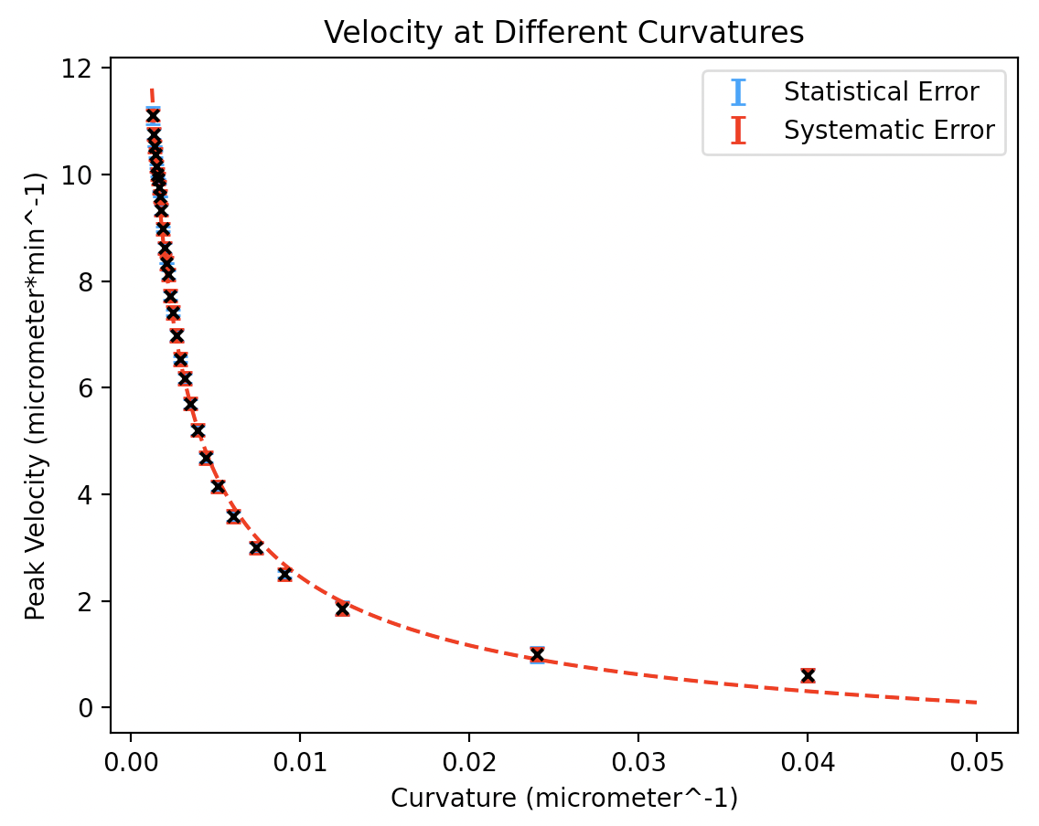
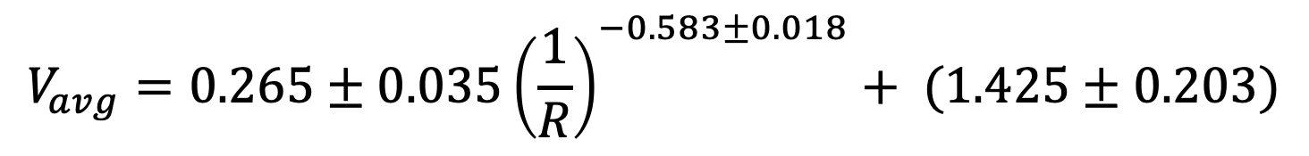
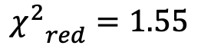
Velocity
$${χ^{2}}_{red}=1.55$$
$$V_{avg}=0.265±0.035{\left(\frac{1}{R}\right)}^{−0.583±0.018}+ (1.425±0.203)$$

Slide 21
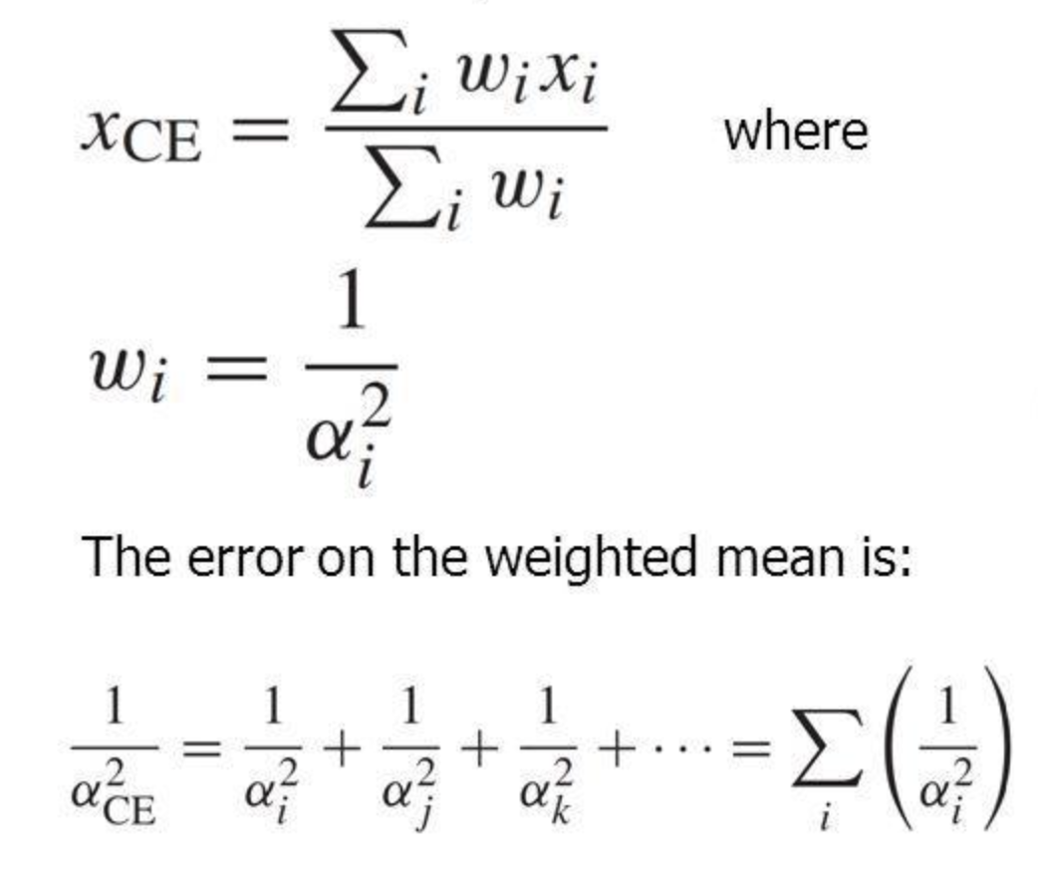
Stochastic Behaviour of the Simulation
In the GRO file utilized throughout, the initial distribution of the bacteria is set randomly.
Multiple simulations and identical velocity analysis were conducted.
An “average” fit was generated with corresponding weighted uncertainties:

Slide 22
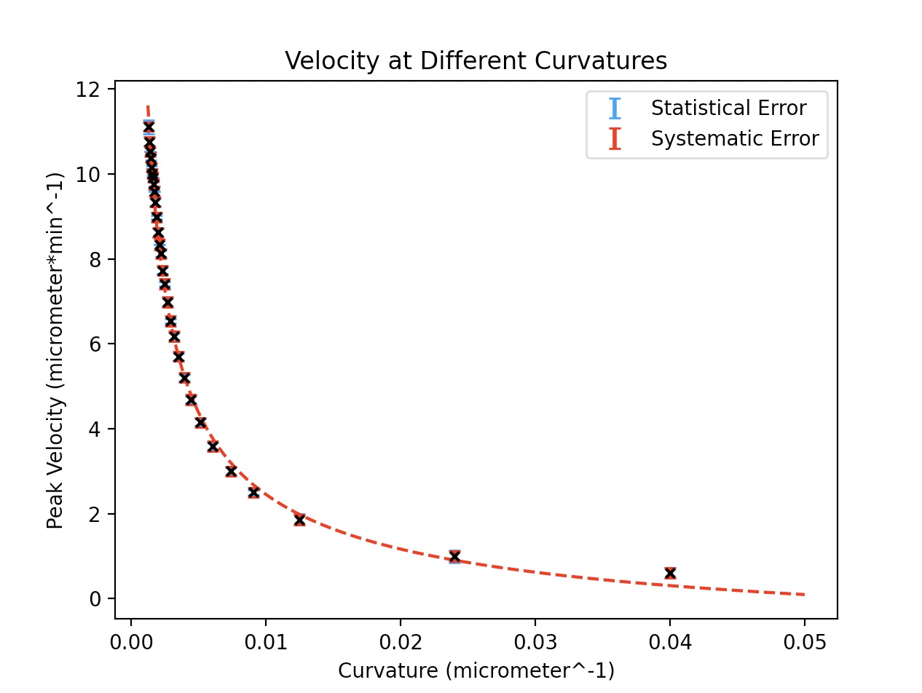
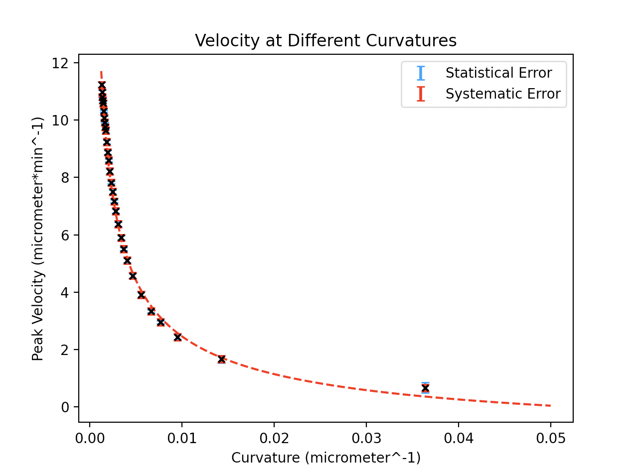
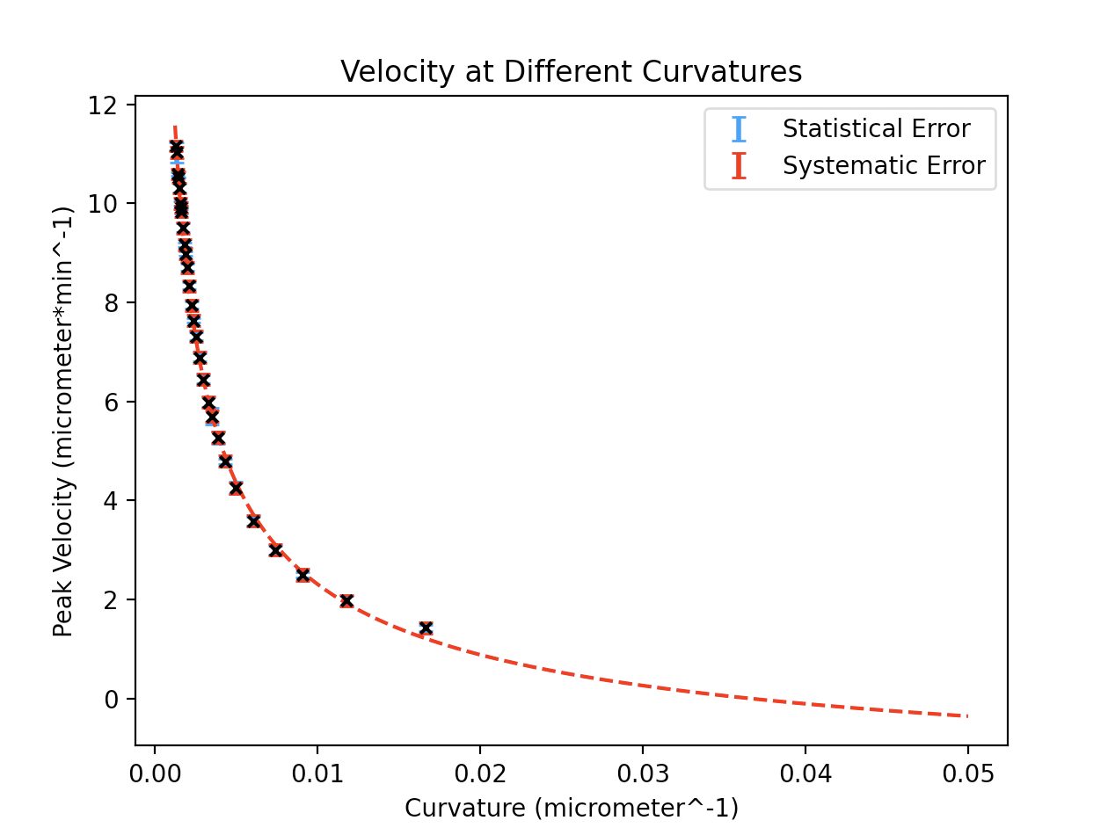
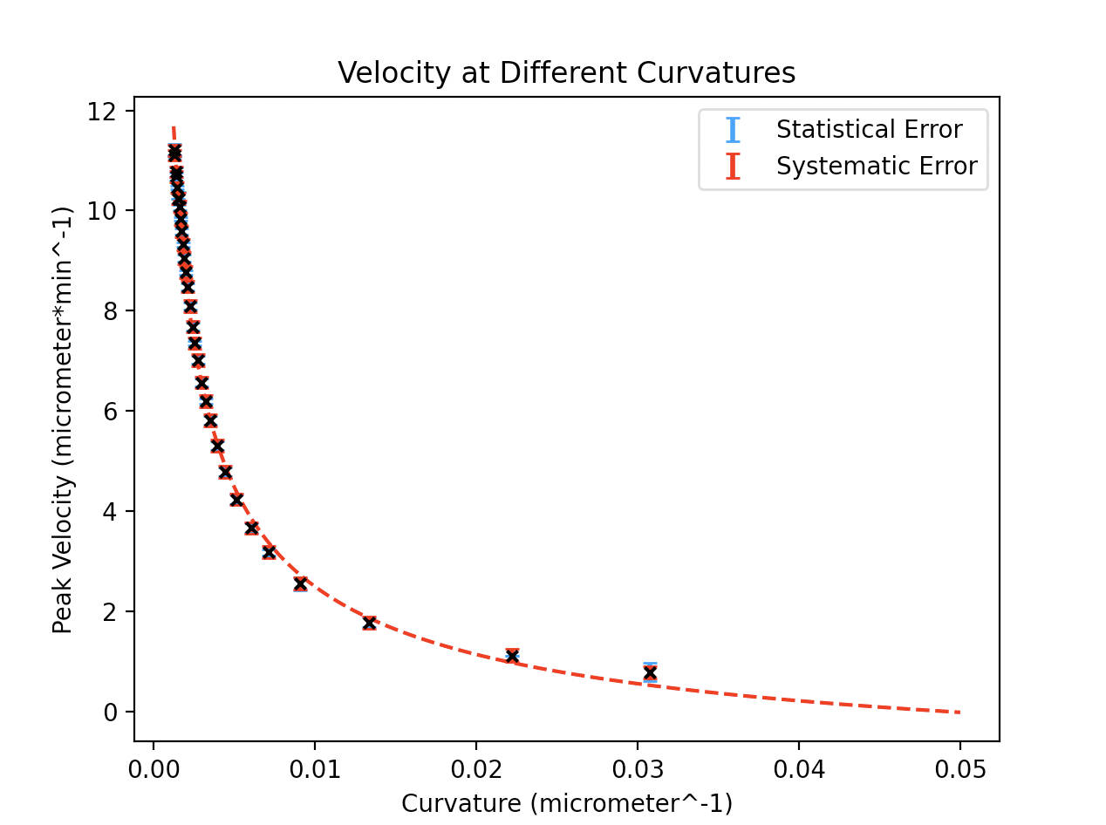
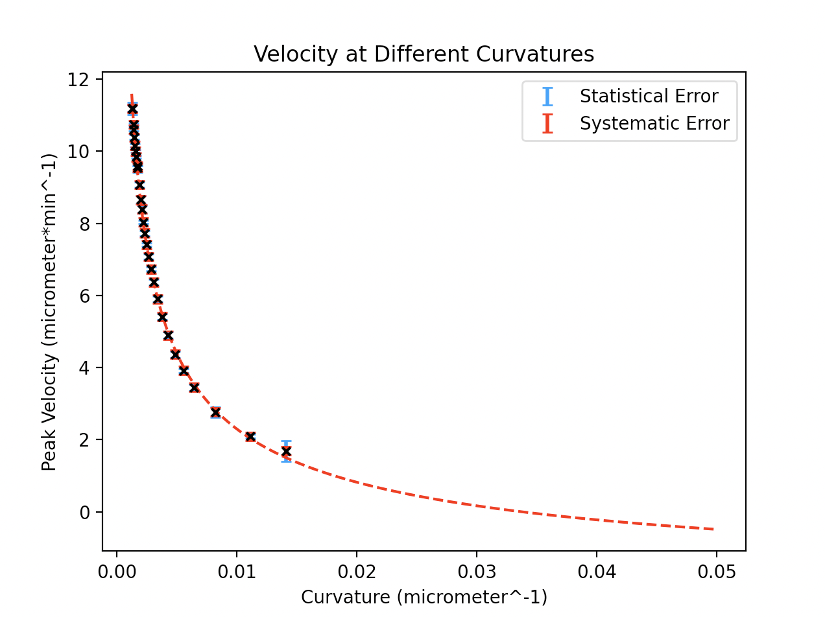
Stochastic Behaviour of the Simulation

Slide 23
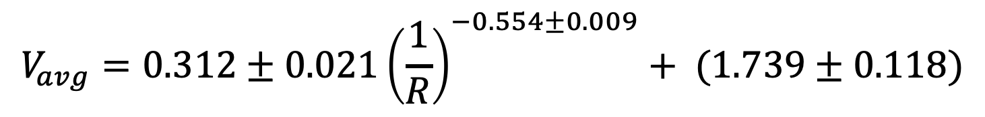
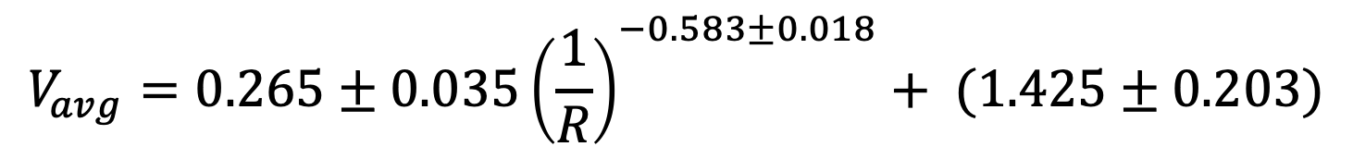
Stochastic Behaviour of the Simulation
Weighted mean:
$$V_{avg}=0.312±0.021{\left(\frac{1}{R}\right)}^{−0.554±0.009}+ (1.739±0.118)$$
Single run:
$$V_{avg}=0.265±0.035{\left(\frac{1}{R}\right)}^{−0.583±0.018}+ (1.425±0.203)$$
The parameters for both power law fits, fall within 1S.D of each other.
Indicating little fluctuation in the emergent phenomena produced by the simulation.

Slide 24
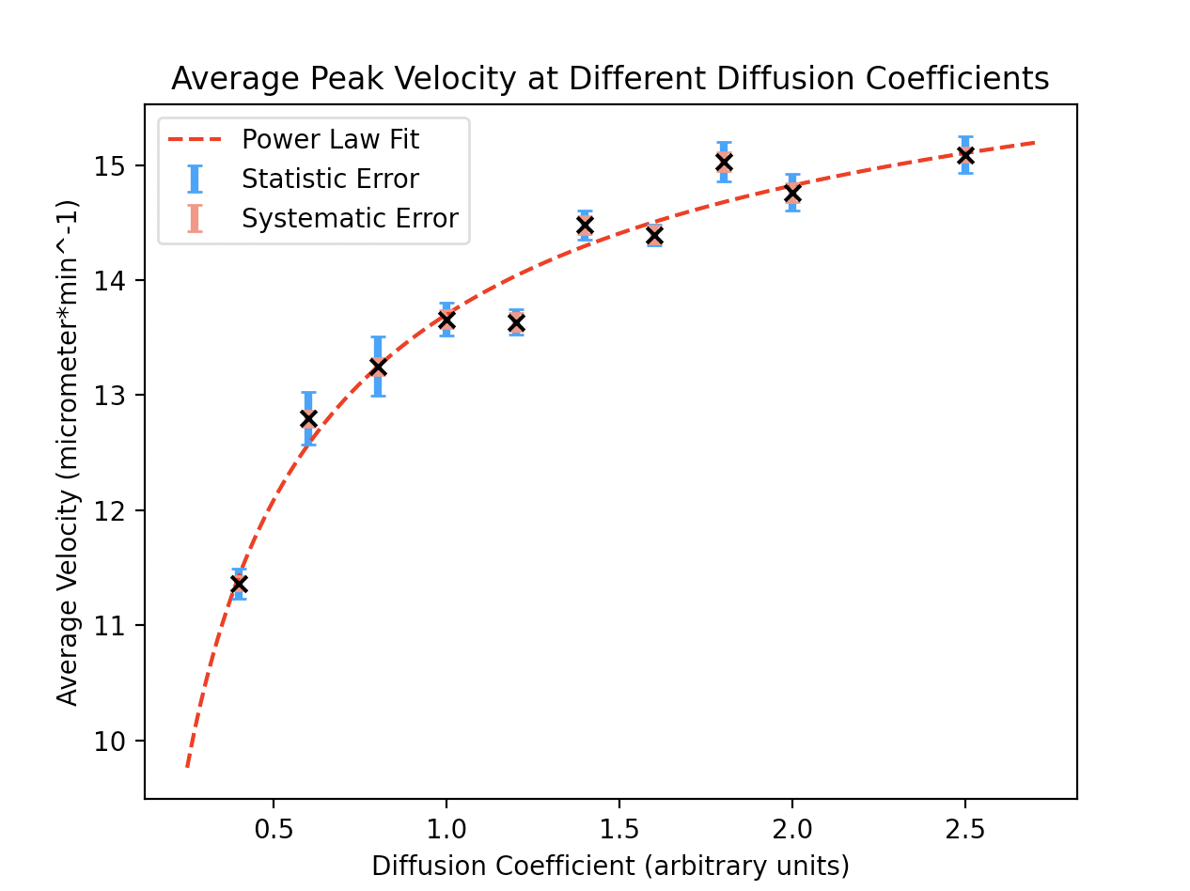
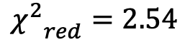
Diffusion Coefficient
To investigate the influence of diffusion coefficient, multiple simulations were run with different diffusion coefficients.
We measure the average velocity for propagation from the center to the edge, a measure of “communication speed”.
We expect this speed to increase with the diffusion coefficient, however, we see a plateau.
$${χ^{2}}_{red}=2.54$$
$$v=(−3.66±0.56)D^{−0.527±0.074}+(17.4±0.54)$$

Slide 25
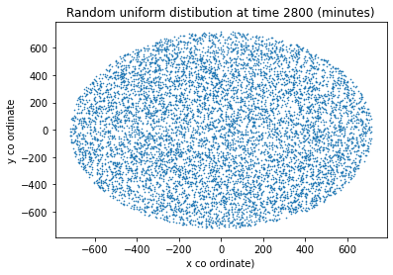
Spatial Distribution
In order to analyse the spatial distribution of a fully formed biofilm we ran a simulation starting from one bacterium and then growing outwards.

Slide 26

Spatial Distribution
The Ripley K function measures the probability of finding another particle a distance r from a candidate in a set of spatial coordinates.
We utilised an astropy.stats module to calculate this in python.
We compared our cell positions to a generated random distribution.
We normalised all resultant k values using Besag’s proposal:
$$L(r)=\sqrt{\frac{K(r)}{π}}$$

Slide 27
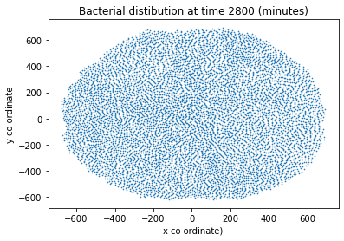
Spatial Distribution

Slide 28
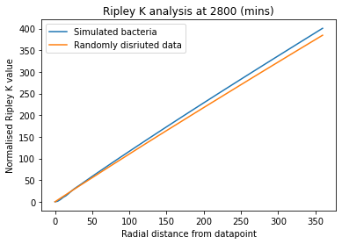
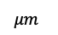
Spatial Distribution
In general the bacteria has a normalised Ripley K value greater than the random dist. this implies greater clustering in the spatial arrangement.
At low radii the Ripley K value appears to be smaller smaller than the null hypothesis.
$μm$

Slide 29
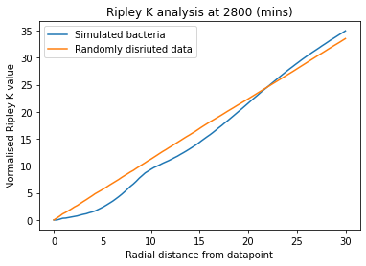
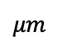
Spatial Distribution
Below radial distances of about 22.5 the random dist. is more clustered than the bacteria.
This is due to the dimensions of the bacteria.
$μm$

Slide 30
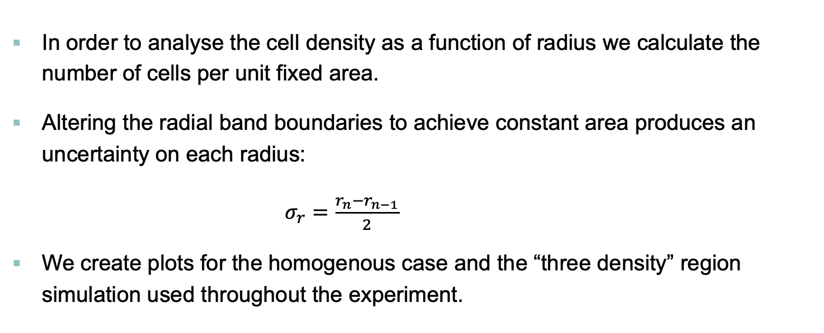
Spatial Distribution
In order to analyse the cell density as a function of radius we calculate the number of cells per unit fixed area.
Altering the radial band boundaries to achieve constant area produces an uncertainty on each radius:
$σ_{r}=\frac{r_{n}−r_{n−1}}{2}$
We create plots for the homogenous case and the “three density” region simulation used throughout the experiment.

Slide 31
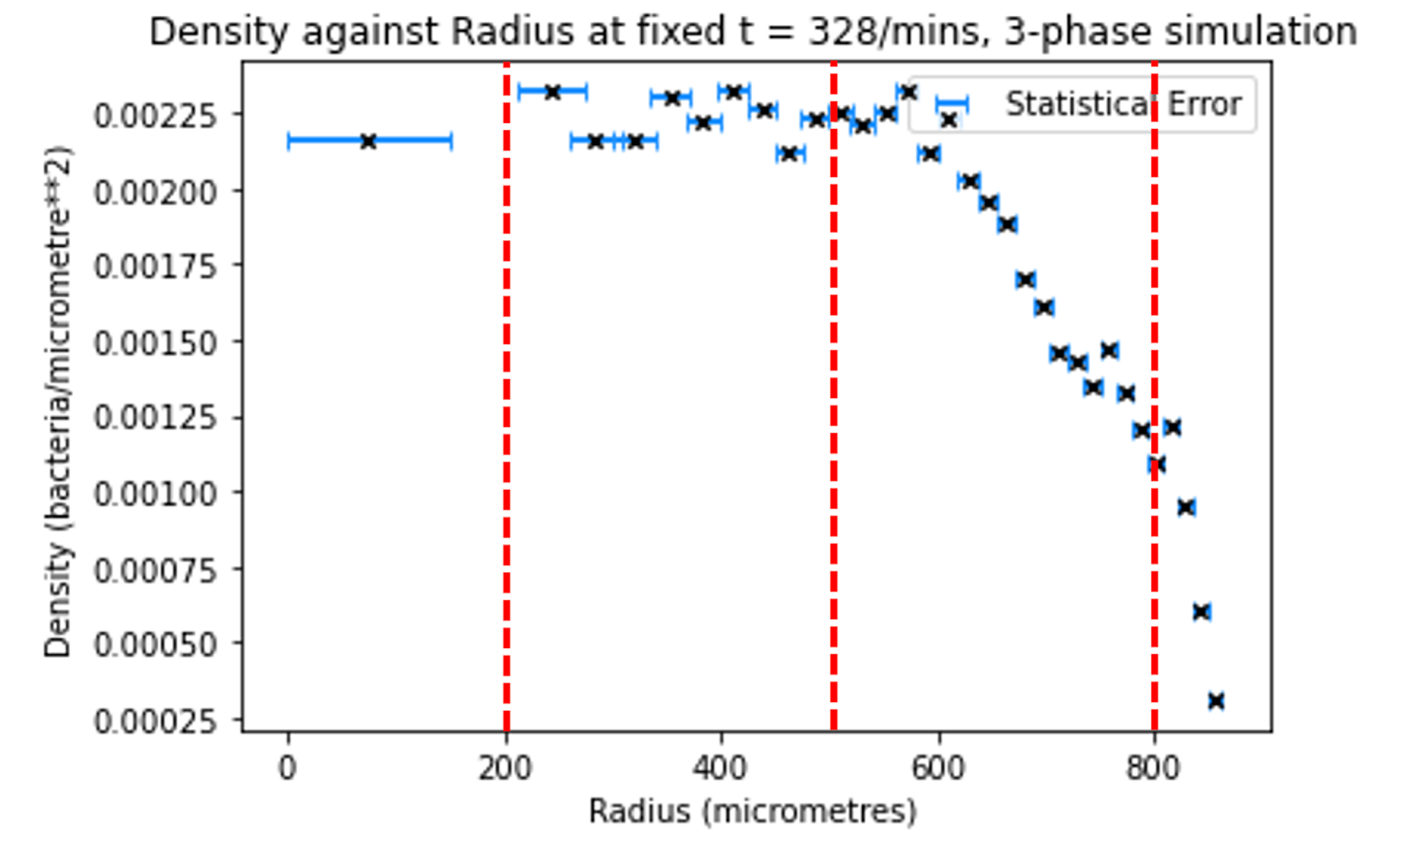
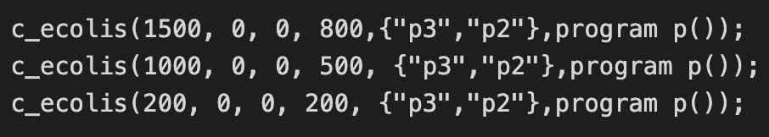
Spatial Distribution
We can see these three phases clearly in the drop of the density between 500 and 800.

Slide 32
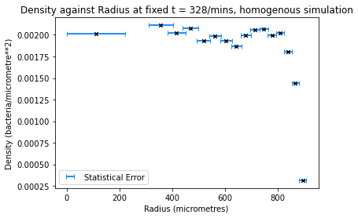
Spatial Distribution
In the homogenous case we see a more constant density with a sharp drop at the outer radii.

Slide 33






Inter-colony Interaction
Simulating 5 separate biofilms in a line, each with equal separation and producing a trigger at the top of the uppermost biofilm, we seek to make a measurement of how fast the “information” of glutamate starvation can travel across independent biofilms.
We also attempt to determine if the potassium signal decays during this process.

Slide 34

Inter-colony Interaction
We decided to treat each biofilm as a point mass, with an average concentration per bacteria that essentially turns on and off during a potassium trigger.
This is done by averaging over the whole biofilm at a given time and calculating the average potassium concentration per unit cell.
From this we can plot graphs of entire biofilm concentration levels against time.

Slide 35

Inter-colony Interaction
The time measurement have an associated uncertainty of 0.5min due to the time step of the simulation.
The position of each biofilm is treated as a point mass in this situation.
We are not interested in measuring the position of the potassium wave here, only the peak overall concentration of the biofilm.
We measure how fast this travels from our 1st colony to the 5th colony, e.g- through the 5 separate point masses.

Slide 36
Agent Based Models
CELLENGINE: Physics engine developed to simulate large colonies, optimized for rod shaped bacterium, such as B. subtilis
PROSPEC: A guarded command-based language developed for modelling cooperative systems
CELLPRO: A probabilistic timed automata-based library that simulates gene expression dynamics using digital proteins. These proteins are then used to drive cell behaviour
CELLNUTRIENT & CELLSIGNALS: Control the external environment. Allows storage of concentration signal at each grid location.
GRO: is the central subsystem of the simulator

Slide 37



Velocity
For a two-dimensional system, curvature 𝐶 is given by:
Starting from the generic reaction-diffusion equation:
$$C=\frac{1}{R}$$
We can use a 1st order perturbation to derive the Eikonal Curvature equation:
$$\frac{∂C}{∂t}=p+D∇^{2}C$$
The “−𝐷𝐶” term can be thought of as a curvature correction to the wave speed.
We wish to determine our own relationship between the potassium wavefront average velocity against the curvature
$$V_{N}=u−DC=u−\frac{D}{R}$$

Slide 38



Spatial Distribution
In order to analyse the cell density as a function of radius we calculate the number of cells per unit fixed area.
The area of subsequent radial bands boundaries was altered using the relationship:
Hence the density is n/area where n is the no_bacteria inside a radial band and A is the area:
This produces an uncertainty on the radius:
$σ_{r}=\frac{r_{n}−r_{n−1}}{2}$
We plot for the simulation used throughout the experiment with 3 phases of density and compare to the case where we use a homogenous distribution.
$$r_{n}=\sqrt{n{dr}^{2}}$$
dr: central circle size
$r_{n}$: nth radial boundary
A$=πdr^{2}$

